Slide 1
Booking a service through the Therapists Template while NOT logged in
Click to start presentation

Slide 2



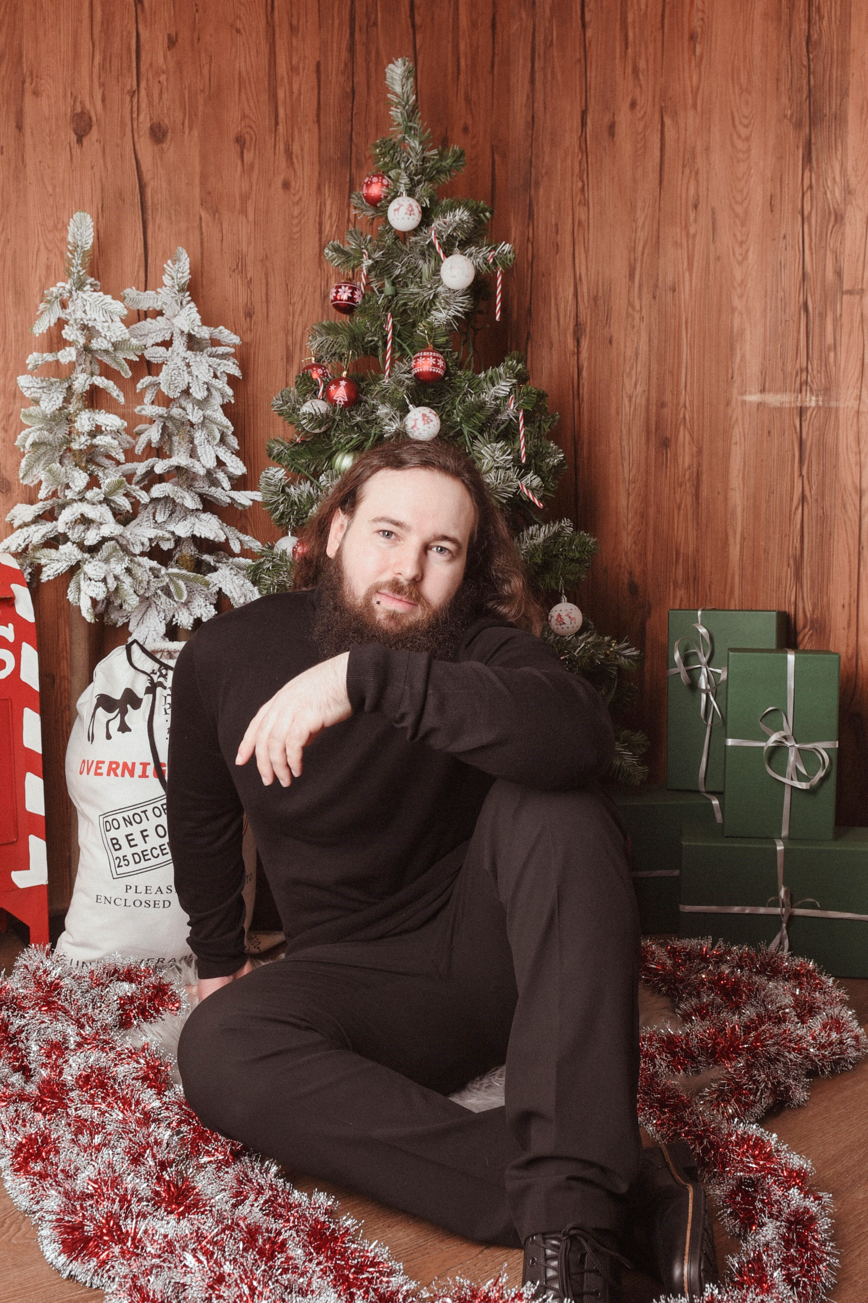

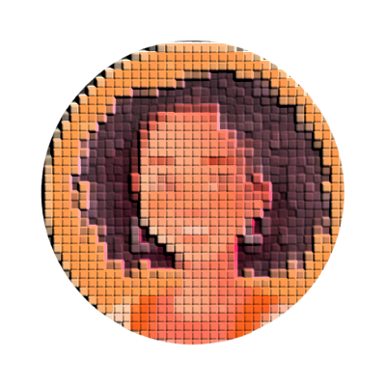


Home
Therapists
Book now
About us
Contacts
Join us
Sign in
Germany Mobile Spa
Friedrichstraße 90, 10117 Berlin
Germany
Find by city
Services
Sort by city
Male
Berlin
Roger Iskrenov Personal Yoga Trainer
Unter den Linden 12, 10117 Berlin 0.19 km away
Hamburg
Liam Harrison Sports Massage Therapist
Schulterblatt 36, 20357 Hamburg 257.54 km away
Stuttgard
Marcus Petrov Myofascial Release Therapist
Königstraße 44, 70173 Stuttgart 511.06 km away
Jasper Malik Thai Yoga Massage Trainer
Neckarstraße 115, 70190 Stuttgart 509.21 km away

Slide 3
Home
Therapists
Book now
About us
Contacts
Join us
Sign in
Germany Mobile Spa
Friedrichstraße 90, 10117 Berlin
Germany
Find by city
Services
Sort by city
Male
Berlin
Roger Iskrenov Personal Yoga Trainer
Unter den Linden 12, 10117 Berlin 0.19 km away
Hamburg
Liam Harrison Sports Massage Therapist
Schulterblatt 36, 20357 Hamburg 257.54 km away
Stuttgard
Marcus Petrov Myofascial Release Therapist
Königstraße 44, 70173 Stuttgart 511.06 km away
Jasper Malik Thai Yoga Massage Trainer
Neckarstraße 115, 70190 Stuttgart 509.21 km away

Slide 4
Home
Therapists
Book now
About us
Contacts
Join us
Sign in
Germany Mobile Spa
Friedrichstraße 90, 10117 Berlin
Germany
Find by city
Services
Sort by city
Male
Berlin
Roger Iskrenov Personal Yoga Trainer
Unter den Linden 12, 10117 Berlin 0.19 km away
Hamburg
Liam Harrison Sports Massage Therapist
Schulterblatt 36, 20357 Hamburg 257.54 km away
Stuttgard
Marcus Petrov Myofascial Release Therapist
Königstraße 44, 70173 Stuttgart 511.06 km away
Jasper Malik Thai Yoga Massage Trainer
Neckarstraße 115, 70190 Stuttgart 509.21 km away

Slide 5
Home
Therapists
Book now
About us
Contacts
Join us
Sign in
Germany Mobile Spa

Slide 6



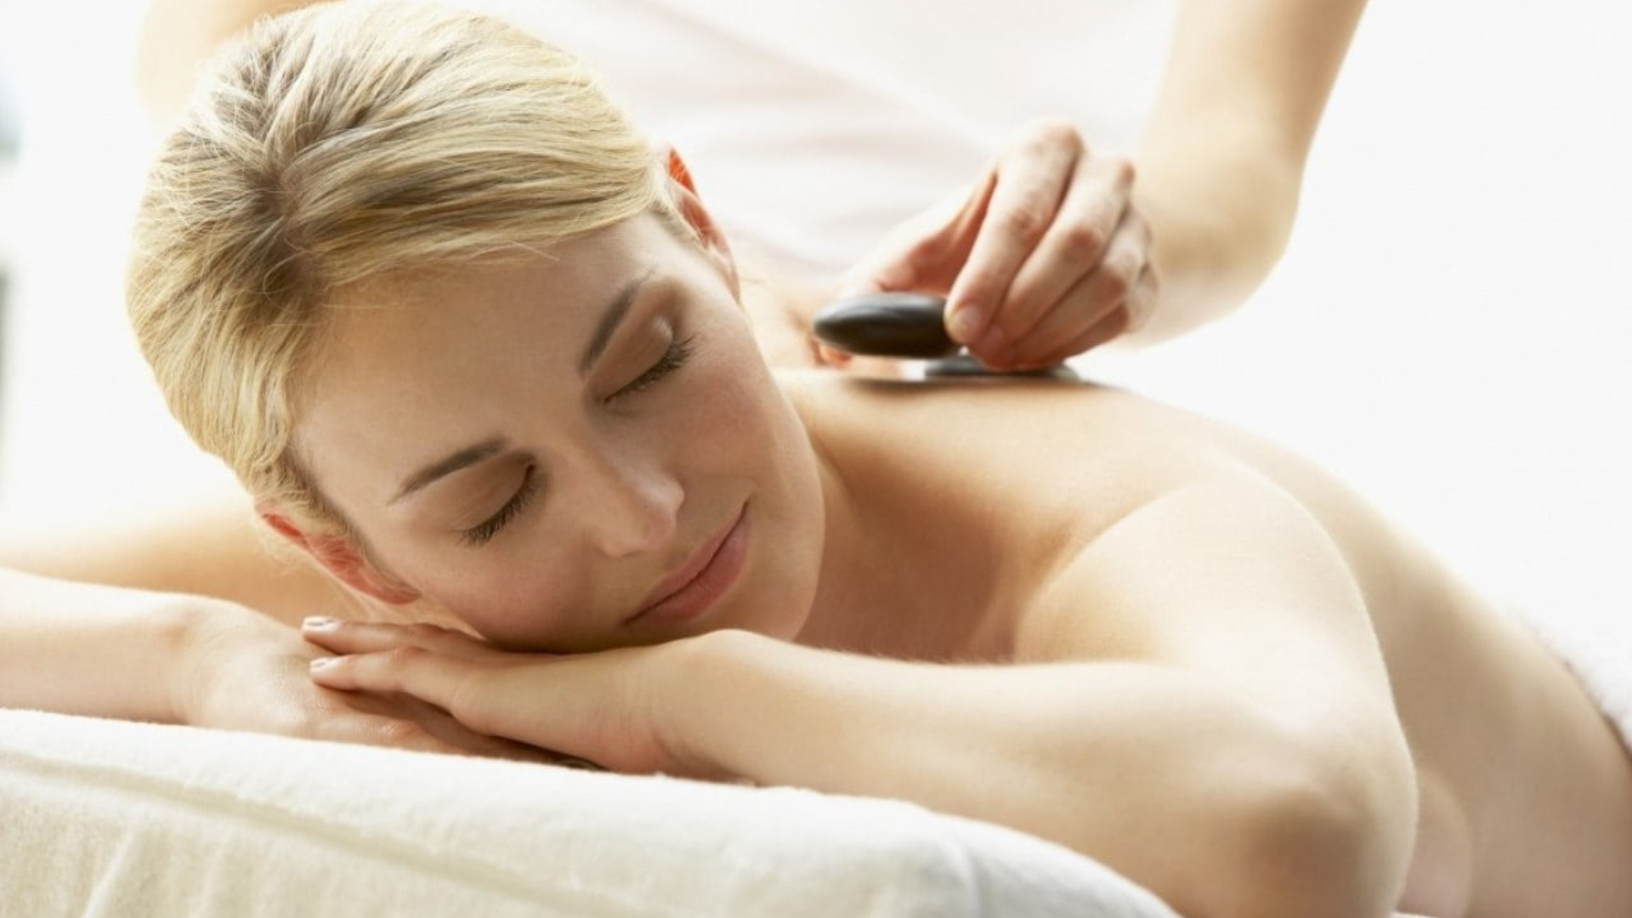
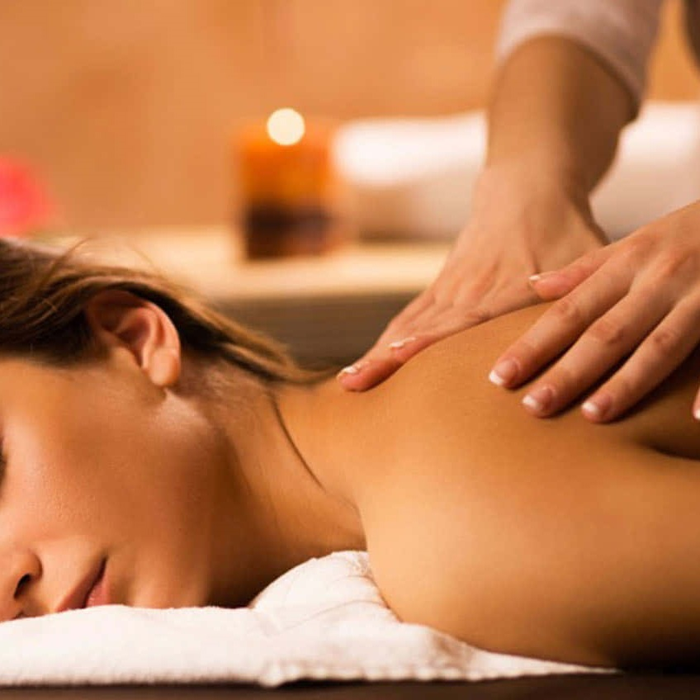
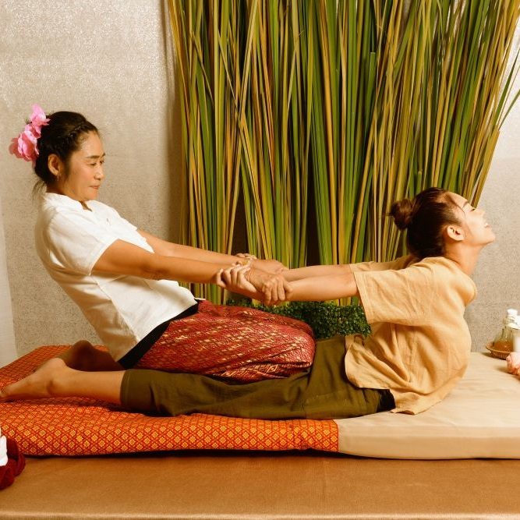
Home
Therapists
Book now
About us
Contacts
Join us
Sign in
Roger Iskrenov
Verified practitioner pronouns: He/Him Field and specialty: Personal yoga trainer
Certifications & Training:
Licensed Massage Therapist (LMT)
Certified Yoga Instructor (RYT-500)
Specializations: Deep Tissue, Myofascial Release, Thai Yoga Massage
"Hi, I’m a certified massage therapist and personal yoga trainer with over 10 years of experience helping clients achieve balance, relaxation, and well-being. My holistic approach combines therapeutic massage techniques with personalized yoga sessions to bring harmony to body and mind."
Gallery
Services

Slide 7
Home
Therapists
Book now
About us
Contacts
Join us
Sign in
Germany Mobile Spa
Roger Iskrenov
Verified practitioner pronouns: He/Him Field and specialty: Personal yoga trainer
Certifications & Training:
Licensed Massage Therapist (LMT)
Certified Yoga Instructor (RYT-500)
Specializations: Deep Tissue, Myofascial Release, Thai Yoga Massage
"Hi, I’m a certified massage therapist and personal yoga trainer with over 10 years of experience helping clients achieve balance, relaxation, and well-being. My holistic approach combines therapeutic massage techniques with personalized yoga sessions to bring harmony to body and mind."
Gallery
Services

Slide 8
Home
Therapists
Book now
About us
Contacts
Join us
Sign in
Germany Mobile Spa
Roger Iskrenov
Verified practitioner pronouns: He/Him Field and specialty: Personal yoga trainer
Certifications & Training:
Licensed Massage Therapist (LMT)
Certified Yoga Instructor (RYT-500)
Specializations: Deep Tissue, Myofascial Release, Thai Yoga Massage
"Hi, I’m a certified massage therapist and personal yoga trainer with over 10 years of experience helping clients achieve balance, relaxation, and well-being. My holistic approach combines therapeutic massage techniques with personalized yoga sessions to bring harmony to body and mind."
Gallery
Services
Services
Our practitioners are available daily from 8.00am until 7.00pm. If requiring services after 7.00pm additional 200 Baht/hour will be added to each service.
Thai Massage
Experience the ancient art of Thai massage. A therapeutic practice that combines gentle stretching, acupressure, and rhythmic movements. This full-body treatment promotes flexibility, relieves tension, and restores balance, leaving you refreshed and rejuvenated.
60 minutes: 25.00 € 90 minutes: 35.00 €
Relaxing Oil Massage
Deep Tissue Massage
Slimming Massage
Jet Lag Massage
Myofascial Massage
Pregnancy Massage
Foot Massage
Foot Scrub
Body Scrub
Facial Treatment
Yoga Personal Trainer
Manicure
Book
Pedicure
Book

Slide 9
Roger Iskrenov
Verified practitioner pronouns: He/Him Field and specialty: Personal yoga trainer
Certifications & Training:
Licensed Massage Therapist (LMT)
Certified Yoga Instructor (RYT-500)
Specializations: Deep Tissue, Myofascial Release, Thai Yoga Massage
"Hi, I’m a certified massage therapist and personal yoga trainer with over 10 years of experience helping clients achieve balance, relaxation, and well-being. My holistic approach combines therapeutic massage techniques with personalized yoga sessions to bring harmony to body and mind."
Gallery
Services
Home
Therapists
Book now
About us
Contacts
Join us
Sign in
Germany Mobile Spa
Services
Our practitioners are available daily from 8.00am until 7.00pm. If requiring services after 7.00pm additional 200 Baht/hour will be added to each service.
Thai Massage
Experience the ancient art of Thai massage. A therapeutic practice that combines gentle stretching, acupressure, and rhythmic movements. This full-body treatment promotes flexibility, relieves tension, and restores balance, leaving you refreshed and rejuvenated.
60 minutes: 25.00 € 90 minutes: 35.00 € 120 minutes: 45.00 €
Relaxing Oil Massage
Deep Tissue Massage
Slimming Massage
Jet Lag Massage
Myofascial Massage
Pregnancy Massage
Foot Massage
Foot Scrub
Body Scrub
Facial Treatment
Yoga Personal Trainer
Book
Manicure
Pedicure

Slide 10
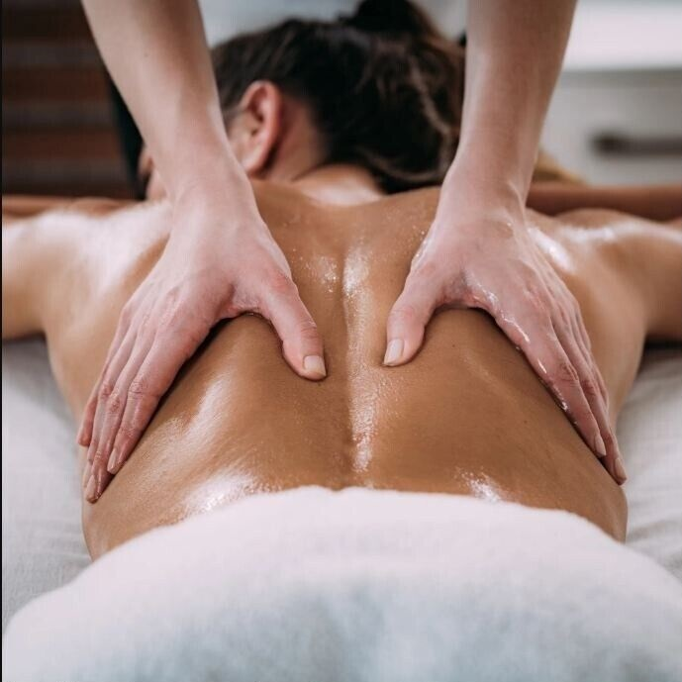
Home
Therapists
Book now
About us
Contacts
Join us
Sign in
Germany Mobile Spa
Services
Our practitioners are available daily from 8.00am until 7.00pm. If requiring services after 7.00pm additional 200 Baht/hour will be added to each service.
Thai Massage
Indulge in a Relaxing Oil Massage, designed to melt away stress and soothe your senses. Smooth, flowing strokes with aromatic oils ease muscle tension, enhance circulation, and promote deep relaxation, leaving you feeling calm, refreshed, and rejuvenated.
60 minutes: 25.00 € 90 minutes: 35.00 € 120 minutes: 45.00 €
Relaxing Oil Massage
Deep Tissue Massage
Slimming Massage
Jet Lag Massage
Myofascial Massage
Pregnancy Massage
Foot Massage
Foot Scrub
Body Scrub
Facial Treatment
Yoga Personal Trainer
Book
Manicure
Pedicure

Slide 11
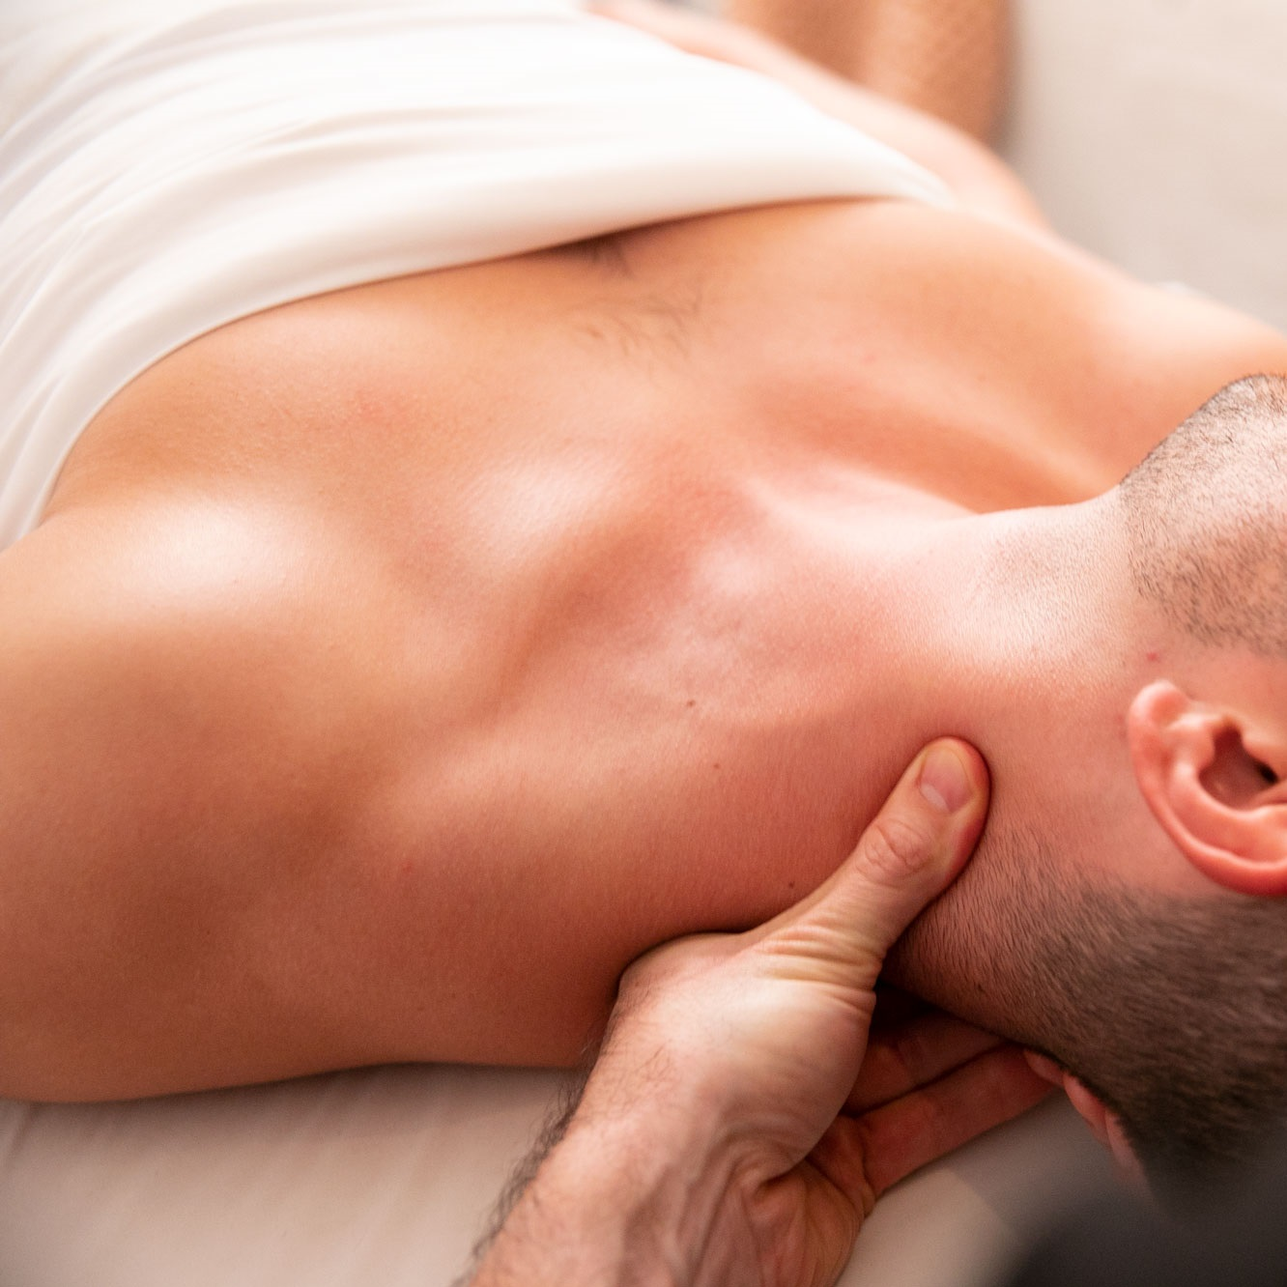
Home
Therapists
Book now
About us
Contacts
Join us
Sign in
Germany Mobile Spa
Services
Our practitioners are available daily from 8.00am until 7.00pm. If requiring services after 7.00pm additional 200 Baht/hour will be added to each service.
Thai Massage
The rejuvenating power of a Deep Tissue Massage, targeting deeper layers of muscle and connective tissue. With firm pressure and focused techniques, this treatment relieves chronic tension, eases tightness, and promotes recovery, leaving you feeling restored and revitalized.
60 minutes: 35.00 € 90 minutes: 50.00 € 120 minutes: 65.00 €
Relaxing Oil Massage
Deep Tissue Massage
Slimming Massage
Jet Lag Massage
Myofascial Massage
Pregnancy Massage
Foot Massage
Foot Scrub
Body Scrub
Facial Treatment
Yoga Personal Trainer
Book
Manicure
Pedicure

Slide 12
Home
Therapists
Book now
About us
Contacts
Join us
Sign in
Germany Mobile Spa
Services
Our practitioners are available daily from 8.00am until 7.00pm. If requiring services after 7.00pm additional 200 Baht/hour will be added to each service.
Thai Massage
The rejuvenating power of a Deep Tissue Massage, targeting deeper layers of muscle and connective tissue. With firm pressure and focused techniques, this treatment relieves chronic tension, eases tightness, and promotes recovery, leaving you feeling restored and revitalized.
60 minutes: 35.00 € 90 minutes: 50.00 € 120 minutes: 65.00 €
Relaxing Oil Massage
Deep Tissue Massage
Slimming Massage
Jet Lag Massage
Myofascial Massage
Pregnancy Massage
Foot Massage
Foot Scrub
Body Scrub
Facial Treatment
Yoga Personal Trainer
Book
Manicure
Pedicure

Slide 13
Home
Therapists
Book now
About us
Contacts
Join us
Sign in
Germany Mobile Spa
Services
Our practitioners are available daily from 8.00am until 7.00pm. If requiring services after 7.00pm additional 200 Baht/hour will be added to each service.
Thai Massage
The rejuvenating power of a Deep Tissue Massage, targeting deeper layers of muscle and connective tissue. With firm pressure and focused techniques, this treatment relieves chronic tension, eases tightness, and promotes recovery, leaving you feeling restored and revitalized.
60 minutes: 35.00 € 90 minutes: 50.00 € 120 minutes: 65.00 €
Relaxing Oil Massage
Deep Tissue Massage
Slimming Massage
Jet Lag Massage
Myofascial Massage
Pregnancy Massage
Foot Massage
Foot Scrub
Body Scrub
Facial Treatment
Yoga Personal Trainer
Book
Manicure
Pedicure

Slide 14
Home
Therapists
Book now
About us
Contacts
Join us
Sign in
Germany Mobile Spa

Slide 15
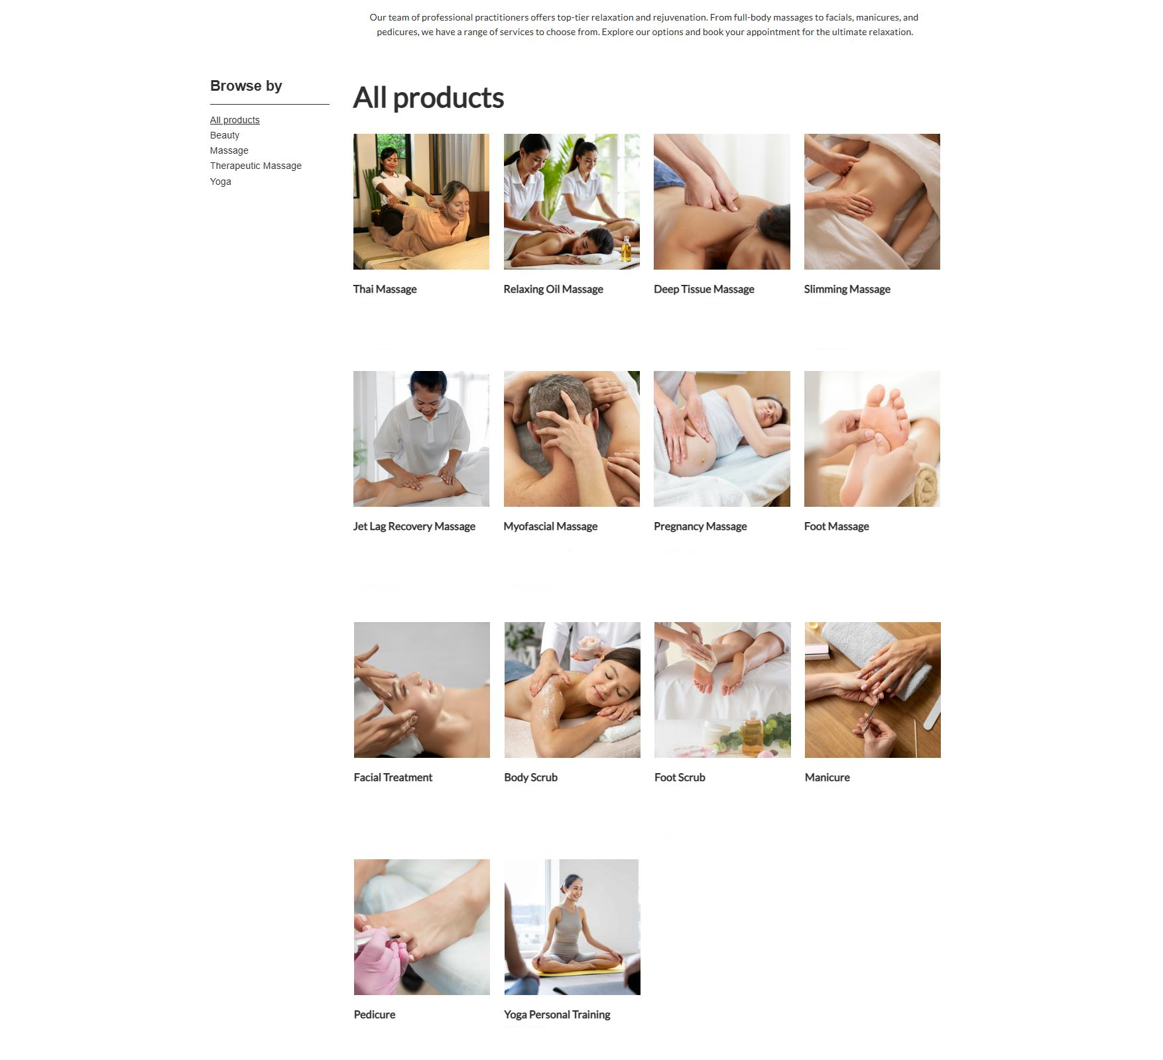
Home
Therapists
Book now
About us
Contacts
Join us
Sign in
Germany Mobile Spa
From 25€ From 25€ From 35€ From 50€
Book
Book
Book
Book
From 45€ From 35€ From 25€ From 25€
Book
Book
Book
Book
From 50€ From 35€ From 30€ From 25€
Book
Book
Book
Book
From 25€ From 50€
Book
Book

Slide 16
Home
Therapists
Book now
About us
Contacts
Join us
Sign in
Germany Mobile Spa
From 25€ From 25€ From 35€ From 50€
Book
Book
Book
Book
From 45€ From 35€ From 25€ From 25€
Book
Book
Book
Book
From 50€ From 35€ From 30€ From 25€
Book
Book
Book
Book
From 25€ From 50€
Book
Book

Slide 17
Home
Therapists
Book now
About us
Contacts
Join us
Sign in
Germany Mobile Spa
From 25€ From 25€ From 35€ From 50€
Book
Book
Book
Book
From 45€ From 35€ From 25€ From 25€
Book
Book
Book
Book
From 50€ From 35€ From 30€ From 25€
Book
Book
Book
Book
From 25€ From 50€
Book
Book

Slide 18


Home
Therapists
Book now
About us
Contacts
Join us
Sign in
Germany Mobile Spa
Join us
Sign in
Register a new account
Login with existing account
Sign up with Google
From 25€ From 25€ From 35€ From 50€
Sign in with Google
Book
Book
Book
Book
Sign up with Facebook
Sign in with Facebook
From 45€ From 35€ From 25€ From 25€
Book
Book
Book
Book
From 50€ From 35€ From 30€ From 25€
Book
Book
Book
Book
From 25€ From 50€
Book
Book

Slide 19
We are now redirected to the login/register page
After whichever process is done we are redirected back to finish the booking You can see the login/register processeses in presentations #2 and #3 (Press to continue)

Slide 20
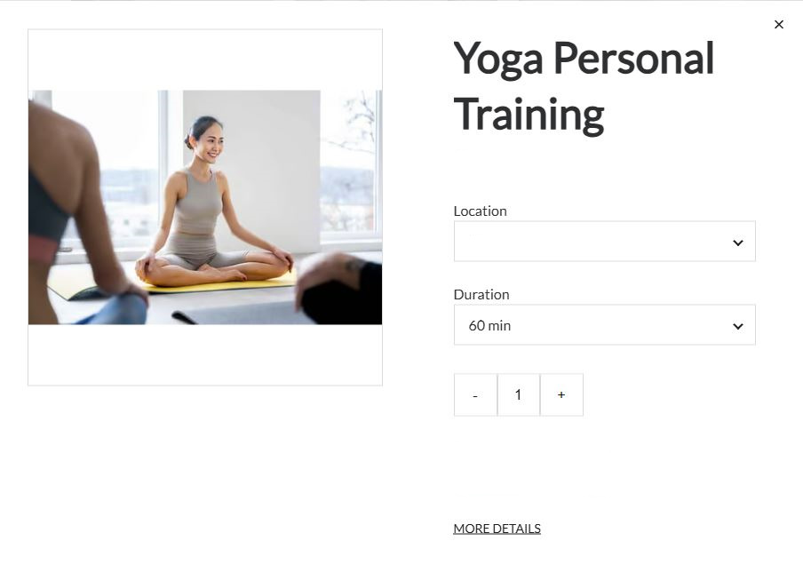
Home
Therapists
Book now
About us
Contacts
Profile
Sign out
Germany Mobile Spa
Deep Tissue Massage
50.00€
From 50€ From 35€ From 30€ From 25€
Unter den Linden 12, 10117 Berlin
Book
Book
Book
Book
From 25€ From 25€ From 35€ From 50€
Book
Book
Book
Book
- +
Attendants
4
Preferred Therapist
Single
Male
Couple
Next
Female
Groups
No preference
From 25€ From 50€
Book
Book
From 45€ From 35€ From 25€ From 25€
Book
Book
Book
Book
From 50€ From 35€ From 30€ From 25€
Book
Book
Book
Book
From 25€ From 50€
Book
Book

Slide 21
Home
Therapists
Book now
About us
Contacts
Profile
Sign out
Germany Mobile Spa
Deep Tissue Massage
50.00€
From 50€ From 35€ From 30€ From 25€
Unter den Linden 12, 10117 Berlin
Book
Book
Book
Book
From 25€ From 25€ From 35€ From 50€
Book
Book
Book
Book
- +
Attendants
4
Preferred Therapist
Single
Male
Couple
Next
Female
Groups
No preference
From 25€ From 50€
Book
Book
From 45€ From 35€ From 25€ From 25€
Book
Book
Book
Book
From 50€ From 35€ From 30€ From 25€
Book
Book
Book
Book
From 25€ From 50€
Book
Book

Slide 22
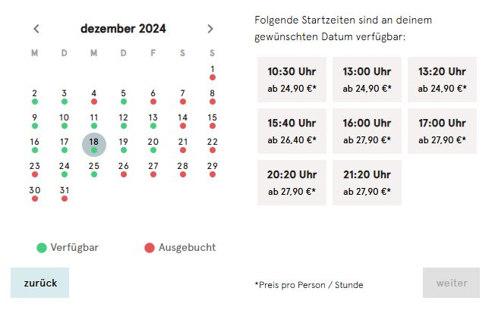
Home
Therapists
Book now
About us
Contacts
Profile
Sign out
Germany Mobile Spa
Deep Tissue Massage
December
50.00€
50.00€
8:00 am
2:00 pm
8:00 pm
From 50€ From 35€ From 30€ From 25€
Unter den Linden 12, 10117 Berlin
Unter den Linden 12, 10117 Berlin
10:00 am
4:00 pm
10:00 pm
Book
Book
Book
Book
Book
Book
Book
Book
From 25€ From 25€ From 35€ From 50€
12:00 am
6:00 pm
Book
Book
Book
Book
- +
Attendants
4
Attendants
4
Preferred Therapist
Available
Booked out
Single
Single
Male
Couple
Next
Back
Couple
Pay
Female
Groups
Groups
No preference
From 25€ From 50€
Book
Book
From 45€ From 35€ From 25€ From 25€
Book
Book
Book
Book
From 50€ From 35€ From 30€ From 25€
Book
Book
Book
Book
From 25€ From 50€
Book
Book

Slide 23
Home
Therapists
Book now
About us
Contacts
Profile
Sign out
Germany Mobile Spa
Deep Tissue Massage
December
50.00€
50.00€
8:00 am
2:00 pm
8:00 pm
From 50€ From 35€ From 30€ From 25€
Unter den Linden 12, 10117 Berlin
Unter den Linden 12, 10117 Berlin
10:00 am
4:00 pm
10:00 pm
Book
Book
Book
Book
Book
Book
Book
Book
12:00 am
6:00 pm
From 25€ From 25€ From 35€ From 50€
Book
Book
Book
Book
- +
Attendants
4
Attendants
4
Preferred Therapist
Available
Booked out
Single
Single
Male
Couple
Next
Back
Couple
Pay
Female
Groups
Groups
No preference
From 25€ From 50€
Book
Book
From 45€ From 35€ From 25€ From 25€
Book
Book
Book
Book
From 50€ From 35€ From 30€ From 25€
Book
Book
Book
Book
From 25€ From 50€
Book
Book

Slide 24
Home
Therapists
Book now
About us
Contacts
Profile
Sign out
Germany Mobile Spa
December
50.00€
8:00 am
2:00 pm
8:00 pm
Unter den Linden 12, 10117 Berlin
10:00 am
4:00 pm
10:00 pm
Book
Book
Book
Book
12:00 am
6:00 pm
From 25€ From 25€ From 35€ From 50€
Book
Book
Book
Book
Attendants
4
Available
Booked out
Back
Single
Pay
Couple
Groups
From 45€ From 35€ From 25€ From 25€
Book
Book
Book
Book
From 50€ From 35€ From 30€ From 25€
Book
Book
Book
Book
From 25€ From 50€
Book
Book

Slide 25
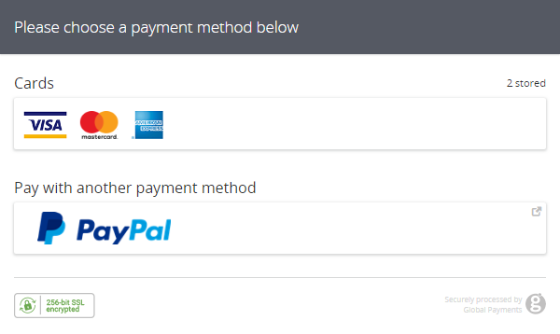
Home
Therapists
Book now
About us
Contacts
Profile
Sign out
Germany Mobile Spa
December
50.00€
8:00 am
2:00 pm
8:00 pm
Unter den Linden 12, 10117 Berlin
10:00 am
4:00 pm
10:00 pm
Book
Book
Book
Book
12:00 am
6:00 pm
From 25€ From 25€ From 35€ From 50€
Book
Book
Book
Book
Attendants
4
Available
Booked out
Back
Single
Pay
Couple
Groups
From 45€ From 35€ From 25€ From 25€
Book
Book
Book
Book
From 50€ From 35€ From 30€ From 25€
Book
Book
Book
Book
From 25€ From 50€
Book
Book

Slide 26
Home
Therapists
Book now
About us
Contacts
Profile
Sign out
Germany Mobile Spa
December
50.00€
8:00 am
2:00 pm
8:00 pm
Unter den Linden 12, 10117 Berlin
10:00 am
4:00 pm
10:00 pm
Book
Book
Book
Book
12:00 am
6:00 pm
From 25€ From 25€ From 35€ From 50€
Book
Book
Book
Book
Attendants
4
Available
Booked out
Back
Single
Pay
Couple
Groups
From 45€ From 35€ From 25€ From 25€
Book
Book
Book
Book
From 50€ From 35€ From 30€ From 25€
Book
Book
Book
Book
From 25€ From 50€
Book
Book

Slide 27
Booking a service through the Booking Template
While NOT logged in
Click to continue presentation

Slide 28
Home
Therapists
Book now
About us
Contacts
Join us
Sign in
Germany Mobile Spa
From 25€ From 25€ From 35€ From 50€
Book
Book
Book
Book
From 45€ From 35€ From 25€ From 25€
Book
Book
Book
Book

Slide 29
Home
Therapists
Book now
About us
Contacts
Join us
Sign in
Germany Mobile Spa
From 25€ From 25€ From 35€ From 50€
Book
Book
Book
Book
From 45€ From 35€ From 25€ From 25€
Book
Book
Book
Book

Slide 30
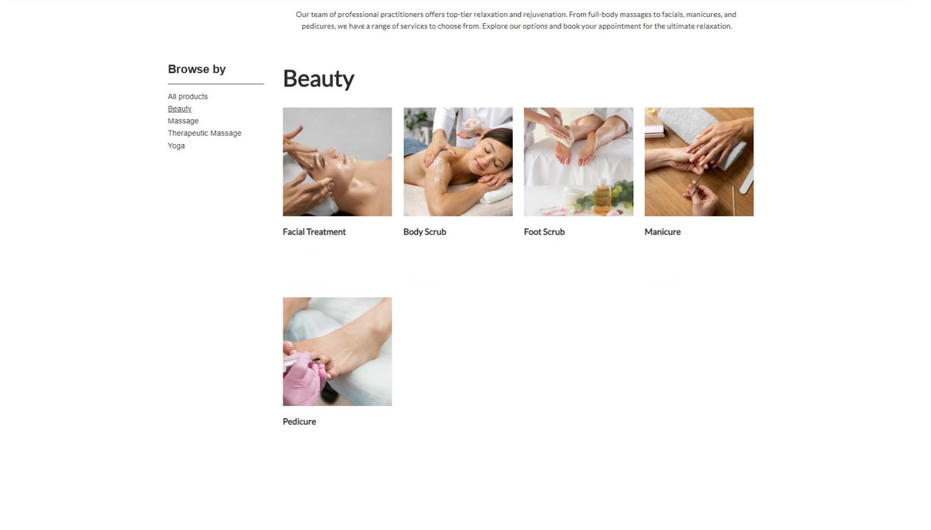
Home
Therapists
Book now
About us
Contacts
Join us
Sign in
Germany Mobile Spa
From 50€ From 35€ From 30€ From 25€
Book
Book
Book
Book
From 25€
Book

Slide 31
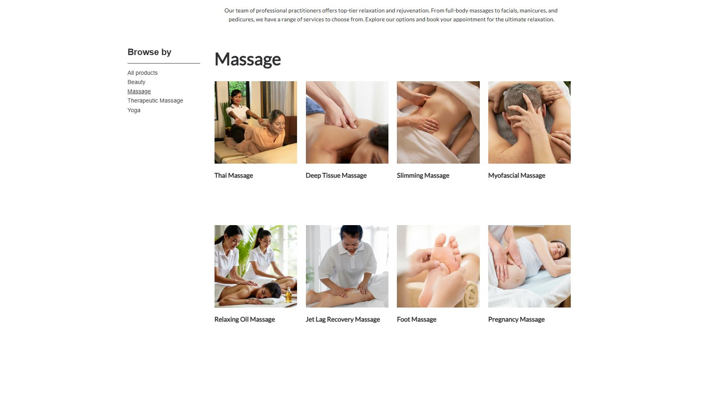
Home
Therapists
Book now
About us
Contacts
Join us
Sign in
Germany Mobile Spa
From 25€ From 35€ From 50€ From 35€
Book
Book
Book
Book
From 25€ From 45€ From 25€ From 25€
Book
Book
Book
Book

Slide 32
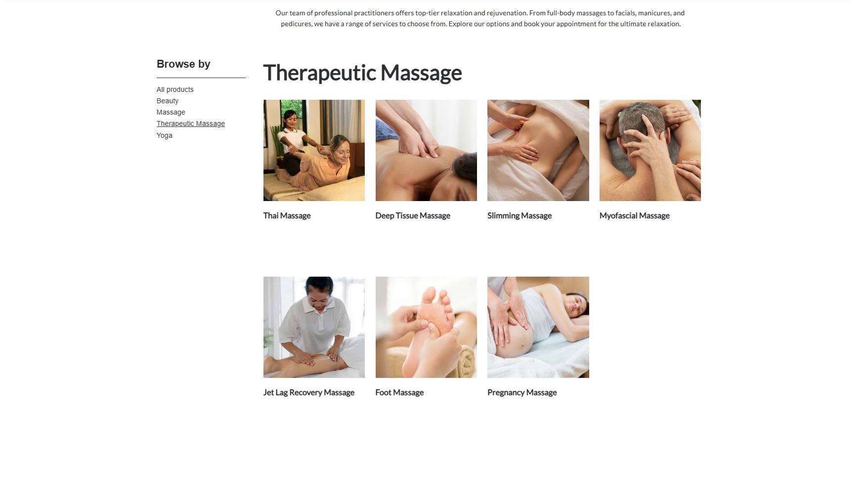
Home
Therapists
Book now
About us
Contacts
Join us
Sign in
Germany Mobile Spa
From 25€ From 35€ From 50€ From 35€
Book
Book
Book
Book
From 45€ From 25€ From 25€
Book
Book
Book

Slide 33
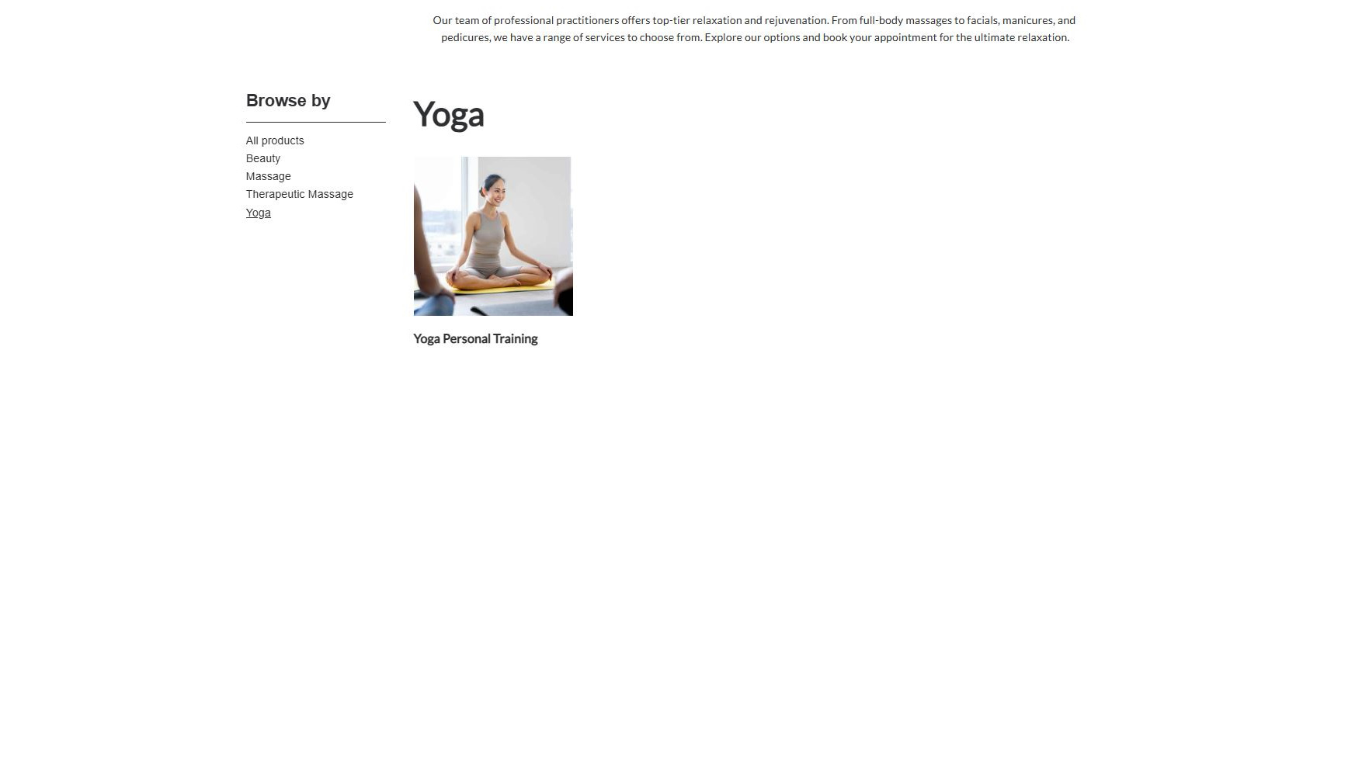
Home
Therapists
Book now
About us
Contacts
Join us
Sign in
Germany Mobile Spa
From 50€
Book

Slide 34
Home
Therapists
Book now
About us
Contacts
Join us
Sign in
Germany Mobile Spa
From 25€ From 25€ From 35€ From 50€
Book
Book
Book
Book
From 45€ From 35€ From 25€ From 25€
Book
Book
Book
Book
From 50€ From 35€ From 30€ From 25€
Book
Book
Book
Book
From 25€ From 50€
Book
Book

Slide 35
From 25€ From 25€ From 35€ From 50€
Book
Book
Book
Book
Home
Therapists
Book now
About us
Contacts
Join us
Sign in
Germany Mobile Spa
From 45€ From 35€ From 25€ From 25€
Book
Book
Book
Book
From 50€ From 35€ From 30€ From 25€
Book
Book
Book
Book
From 25€ From 50€
Book
Book

Slide 36
Home
Therapists
Book now
About us
Contacts
Join us
Sign in
Germany Mobile Spa
From 25€ From 25€ From 35€ From 50€
Book
Book
Book
Book
From 45€ From 35€ From 25€ From 25€
Book
Book
Book
Book
From 50€ From 35€ From 30€ From 25€
Book
Book
Book
Book
From 25€ From 50€
Book
Book

Slide 37
Home
Therapists
Book now
About us
Contacts
Join us
Sign in
Germany Mobile Spa
From 25€ From 25€ From 35€ From 50€
Book
Book
Book
Book
From 45€ From 35€ From 25€ From 25€
Book
Book
Book
Book
From 50€ From 35€ From 30€ From 25€
Book
Book
Book
Book
From 25€ From 50€
Book
Book

Slide 38
Home
Therapists
Book now
About us
Contacts
Join us
Sign in
Germany Mobile Spa
Join us
Sign in
Register a new account
Login with existing account
Sign up with Google
From 25€ From 25€ From 35€ From 50€
Sign in with Google
Book
Book
Book
Book
Sign up with Facebook
Sign in with Facebook
From 45€ From 35€ From 25€ From 25€
Book
Book
Book
Book
From 50€ From 35€ From 30€ From 25€
Book
Book
Book
Book
From 25€ From 50€
Book
Book

Slide 39
We are now redirected to the login/register page
After whichever process is done we are redirected back to this page to pay You can see the login/register processeses in presentations #2 and #3 (Press to continue)

Slide 40
Home
Therapists
Book now
About us
Contacts
Profile
Sign out
Germany Mobile Spa
Deep Tissue Massage
50.00€
From 50€ From 35€ From 30€ From 25€
Unter den Linden 12, 10117 Berlin
Book
Book
Book
Book
From 25€ From 25€ From 35€ From 50€
Book
Book
Book
Book
- +
Attendants
4
Preferred Therapist
Single
Male
Couple
Next
Female
Groups
No preference
From 25€ From 50€
Book
Book
From 45€ From 35€ From 25€ From 25€
Book
Book
Book
Book
From 50€ From 35€ From 30€ From 25€
Book
Book
Book
Book
From 25€ From 50€
Book
Book

Slide 41
Home
Therapists
Book now
About us
Contacts
Profile
Sign out
Germany Mobile Spa
Deep Tissue Massage
50.00€
From 50€ From 35€ From 30€ From 25€
Unter den Linden 12, 10117 Berlin
Book
Book
Book
Book
From 25€ From 25€ From 35€ From 50€
Book
Book
Book
Book
- +
Attendants
4
Preferred Therapist
Single
Male
Couple
Next
Female
Groups
No preference
From 25€ From 50€
Book
Book
From 45€ From 35€ From 25€ From 25€
Book
Book
Book
Book
From 50€ From 35€ From 30€ From 25€
Book
Book
Book
Book
From 25€ From 50€
Book
Book

Slide 42
Home
Therapists
Book now
About us
Contacts
Profile
Sign out
Germany Mobile Spa
Deep Tissue Massage
December
50.00€
50.00€
8:00 am
2:00 pm
8:00 pm
From 50€ From 35€ From 30€ From 25€
Unter den Linden 12, 10117 Berlin
Unter den Linden 12, 10117 Berlin
10:00 am
4:00 pm
10:00 pm
Book
Book
Book
Book
Book
Book
Book
Book
From 25€ From 25€ From 35€ From 50€
12:00 am
6:00 pm
Book
Book
Book
Book
- +
Attendants
4
Attendants
4
Preferred Therapist
Available
Booked out
Single
Single
Male
Couple
Next
Back
Couple
Pay
Female
Groups
Groups
No preference
From 25€ From 50€
Book
Book
From 45€ From 35€ From 25€ From 25€
Book
Book
Book
Book
From 50€ From 35€ From 30€ From 25€
Book
Book
Book
Book
From 25€ From 50€
Book
Book

Slide 43
Home
Therapists
Book now
About us
Contacts
Profile
Sign out
Germany Mobile Spa
Deep Tissue Massage
December
50.00€
50.00€
8:00 am
2:00 pm
8:00 pm
From 50€ From 35€ From 30€ From 25€
Unter den Linden 12, 10117 Berlin
Unter den Linden 12, 10117 Berlin
10:00 am
4:00 pm
10:00 pm
Book
Book
Book
Book
Book
Book
Book
Book
From 25€ From 25€ From 35€ From 50€
12:00 am
6:00 pm
Book
Book
Book
Book
- +
Attendants
4
Attendants
4
Preferred Therapist
Available
Booked out
Single
Single
Male
Couple
Next
Back
Couple
Pay
Female
Groups
Groups
No preference
From 25€ From 50€
Book
Book
From 45€ From 35€ From 25€ From 25€
Book
Book
Book
Book
From 50€ From 35€ From 30€ From 25€
Book
Book
Book
Book
From 25€ From 50€
Book
Book

Slide 44
Home
Therapists
Book now
About us
Contacts
Profile
Sign out
Germany Mobile Spa
December
50.00€
8:00 am
2:00 pm
8:00 pm
Unter den Linden 12, 10117 Berlin
10:00 am
4:00 pm
10:00 pm
Book
Book
Book
Book
From 25€ From 25€ From 35€ From 50€
12:00 am
6:00 pm
Book
Book
Book
Book
Attendants
4
Available
Booked out
Back
Single
Pay
Couple
Groups
From 45€ From 35€ From 25€ From 25€
Book
Book
Book
Book
From 50€ From 35€ From 30€ From 25€
Book
Book
Book
Book
From 25€ From 50€
Book
Book

Slide 45
Home
Therapists
Book now
About us
Contacts
Profile
Sign out
Germany Mobile Spa
December
50.00€
8:00 am
2:00 pm
8:00 pm
Unter den Linden 12, 10117 Berlin
10:00 am
4:00 pm
10:00 pm
Book
Book
Book
Book
From 25€ From 25€ From 35€ From 50€
12:00 am
6:00 pm
Book
Book
Book
Book
Attendants
4
Available
Booked out
Back
Single
Pay
Couple
Groups
From 45€ From 35€ From 25€ From 25€
Book
Book
Book
Book
From 50€ From 35€ From 30€ From 25€
Book
Book
Book
Book
From 25€ From 50€
Book
Book

Slide 46
Home
Therapists
Book now
About us
Contacts
Profile
Sign out
Germany Mobile Spa
December
50.00€
8:00 am
2:00 pm
8:00 pm
Unter den Linden 12, 10117 Berlin
10:00 am
4:00 pm
10:00 pm
Book
Book
Book
Book
12:00 am
6:00 pm
From 25€ From 25€ From 35€ From 50€
Book
Book
Book
Book
Attendants
4
Available
Booked out
Back
Single
Pay
Couple
Groups
From 45€ From 35€ From 25€ From 25€
Book
Book
Book
Book
From 50€ From 35€ From 30€ From 25€
Book
Book
Book
Book
From 25€ From 50€
Book
Book

Slide 47
From 25€ From 25€ From 35€ From 50€
Book
Book
Book
Book
Home
Therapists
Book now
About us
Contacts
Profile
Sign out
Germany Mobile Spa
From 45€ From 35€ From 25€ From 25€
Book
Book
Book
Book
From 50€ From 35€ From 30€ From 25€
Book
Book
Book
Book
From 25€ From 50€
Book
Book

Slide 48
The end
Click to exit

